Slide 1
Models of the Atom

Slide 2
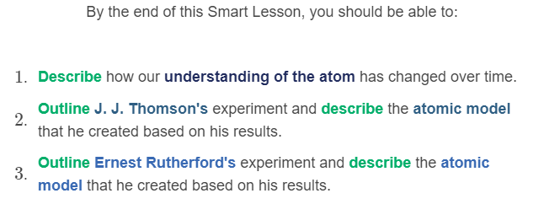
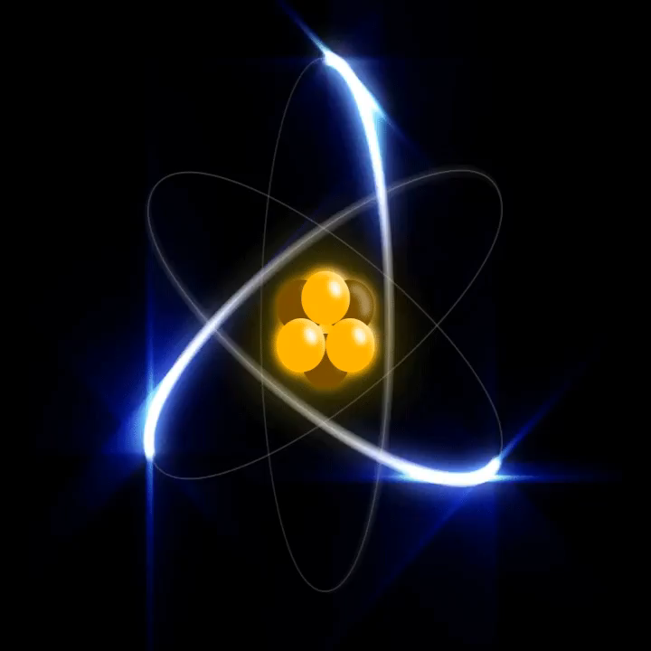

Slide 3
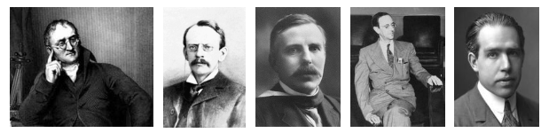
Humans have been trying to understand and make sense of the world around us for a very long time.
Before we understood very much at all about atoms, some very clever scientists came up with different models to describe their structure and behaviour.

Slide 4

Most of these scientists built on each others' ideas to develop their models.
In science, ideas are continually developing. We can never claim to know everything about the world we live in, which is why there are still so many scientists around today.
Our current model of the atom will likely prove to be incorrect when new scientific discoveries are made - maybe they will be made by you!

Slide 5


Slide 6

The concept of atoms was first proposed by Democritus, a Greek philosopher, in 460BC.
Democritus thought that atoms were tiny, solid spheres with no smaller particles within them. He also predicted that atoms could not be destroyed.
Because atoms are far too small to be seen, his ideas were dismissed and ignored for more than 2000 years.

Slide 7
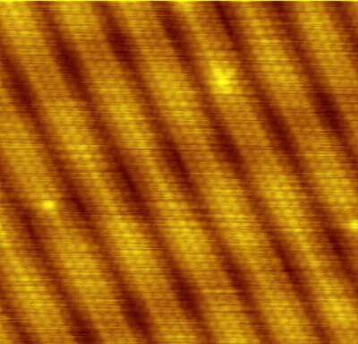
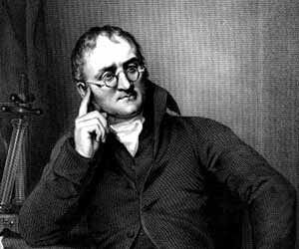
John Dalton came up with the atomic theory in 1808, after examining the work of other chemists and doing his own experiments.
He concluded that Democritus was correct in that matter was made up of tiny separate particles.

Slide 8
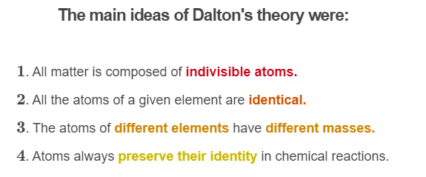
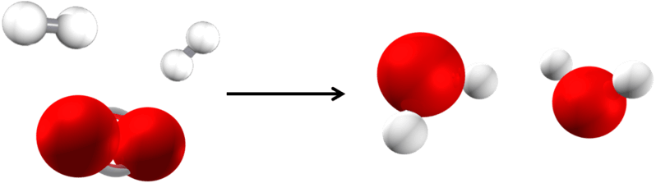

Slide 9
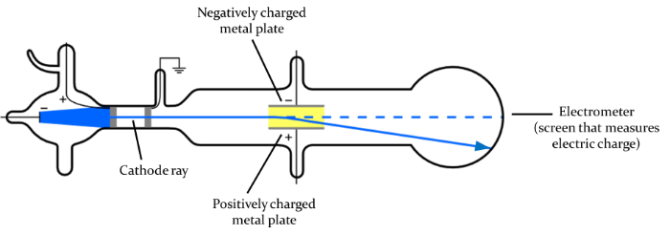
Electrons were discovered in 1897 by J. J. Thomson, who carried out a cathode ray experiment.
It was already known that when an electrical current was passed through a vacuum, a stream of glowing materials could be seen. This stream is called a cathode ray. Thomson discovered that the cathode ray could be bent by electrical and magnetic fields.
This led Thomson to conclude that the stream was made of negatively charged particles which were later called electrons.

Slide 10


Slide 11
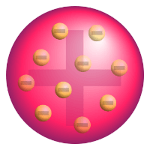
After Thomson discovered electrons, he proposed a model of the atom that is now called the plum pudding model.
This model has negatively charged electrons scattered evenly throughout a positive sphere.
Thomson knew that atoms were electrically neutral so he thought atoms must have the positive sphere to cancel out the negative electrons. This was the first evidence that atoms were made up of even smaller particles.

Slide 12
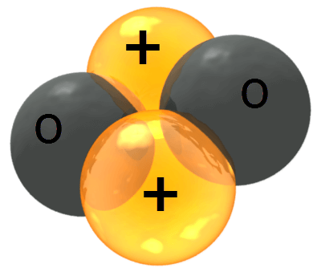

Protons were discovered by Ernest Rutherford when he carried out a gold foil experiment in 1911.
In this experiment, Rutherford fired positive alpha particles at a very thin sheet of gold foil. Alpha particles are a type of radiation made up of two protons and two neutrons.

Slide 13
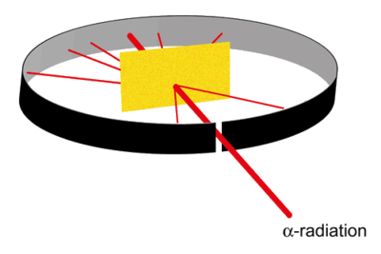
If Thomson's model of the atom was correct, the alpha particles should have gone straight through the foil without being deflected at all.
Most of the particles did pass through the gold foil without changing direction. However, some of the particles were slightly deflected, and a few of particles were deflected straight back!

Slide 14


Slide 15
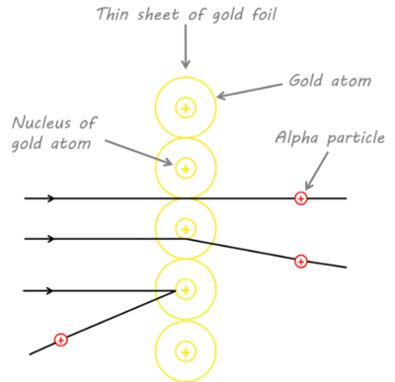
Rutherford's experiment led him to conclude that a small, dense mass exists at the centre of every atom; he called this the nucleus.
Since some of the alpha particles were deflected directly back, the nucleus must be very dense. It also must be positively charged in order to repel the positively charged alpha particles. Rutherford called the positively charged particles in the nucleus protons.

Slide 16
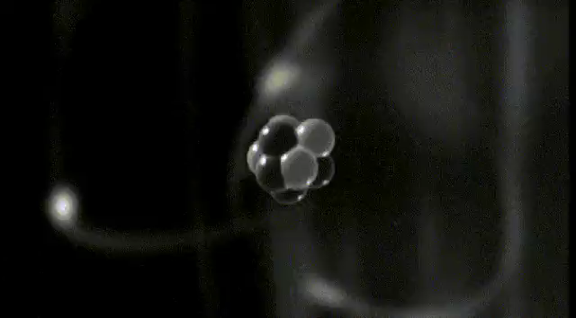
Since most of the alpha particles were not deflected at all by the nucleus, Rutherford concluded that the nucleus was very small.
This means that most of an atom is empty space.

Slide 17
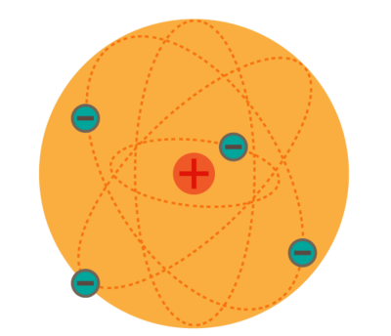
After discovering the nucleus, Rutherford proposed the solar system model of the atom.
In this model, the negatively charged electrons orbit around the nucleus which contains positively charged protons.

Slide 18
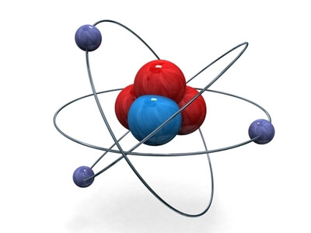
Neutrons were discovered by one of Rutherford's students, James Chadwick, in 1932.
Chadwick reasoned that a neutral subatomic particle must exist in the nucleus of the atom. This was because if there was nothing else in the nucleus the positive protons would repel each other, ripping the nucleus apart.

Slide 19
Chadwick's discovery of neutrons led to the development of the Chadwick-Bohr model of the atom, which is the model commonly used today.
This model has protons and neutrons making up a positively charged nucleus, and electrons orbiting around the nucleus in specific energy levels called orbitals. Each orbital holds a certain number of electrons.

